Slide 1

Narrating an Event
Day #2

Slide 2
Homework
For Tuesday, Read pp. 29-48 in Bird by Bird
Journal 2
For Wednesday, Read “Henry Country” and “Losing My Innocence”
Journal 3

Slide 3
Writing Process
You will be asked to journal your thoughts, and journals will be due at the end of each week.
Use your journals as prompts of the essay. Turn one prompt into a first draft.
I will grade first drafts as participation points and will give you feedback on them.
Use the feedback to revise for the peer review draft.
You will email your draft to two students—I will send their emails to you. ‘CC me on the email exchange.
After you receive your peer review draft, revise for the final instructor draft. (This is the one that receives a grade based on merit.)

Slide 4
Narrating an Event
D2L/Content/Week 1/Day 2

Slide 5
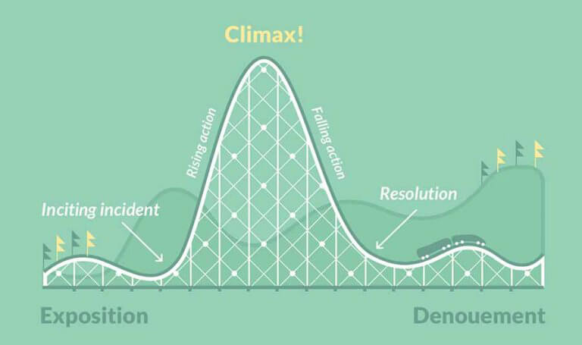
Narrative Arc
This is a basic story structure.

Slide 6
Academic Study on Story Structure
https://www.youtube.com/watch?v=Cs8OTGJR0V0

Slide 7
Where do I begin?
“Let’s get one thing clear right now, shall we? There is no Idea Dump, no Story Central, no Island of the Buried Bestsellers; good story ideas seem to come quite literally from nowhere, sailing you right out of the empty sky: two previously unrelated ideas come together and make something new under the sun. Your job isn’t to find these ideas but to recognize them when they show up.”
--Steven King, On Writing

Slide 8
Journal Prompt #2
You are going to start drafting your narrative by writing three different stories. They need only be a paragraph in length. Look at the prompt on the assignment sheet and begin to write about three different events.

